Slide 1
STA 4102 Final
Matthias Rathbun
5296483

Slide 2
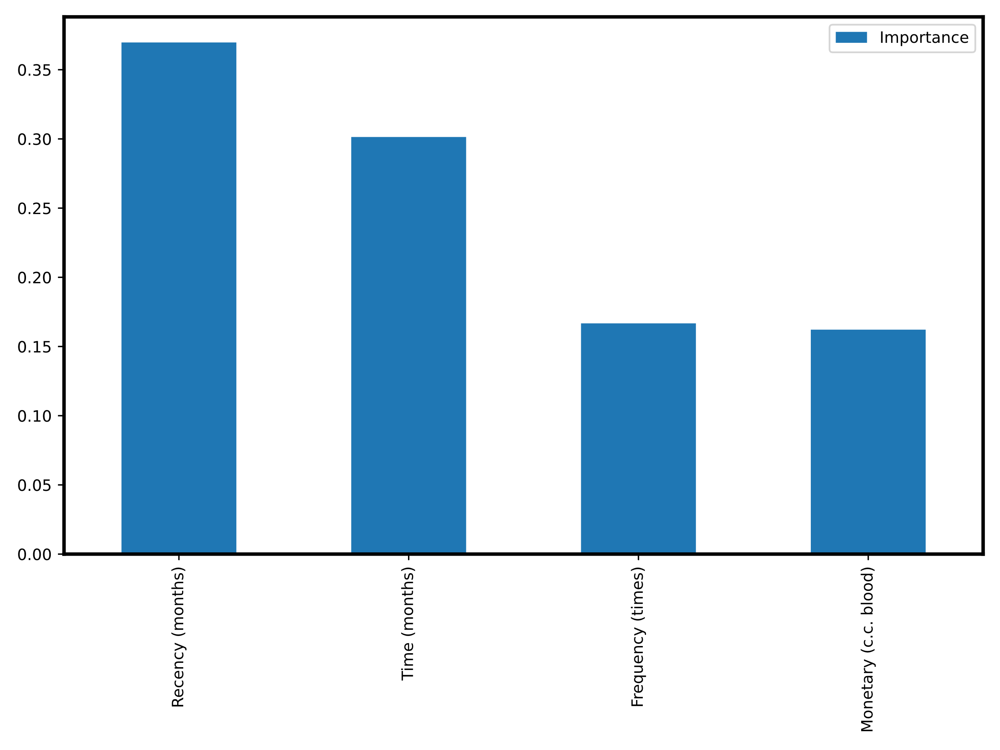
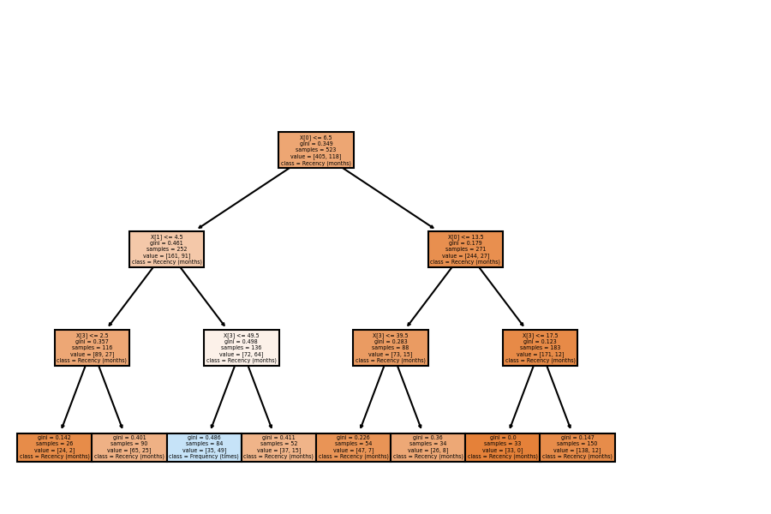
Q1 Analysis
Decision Tree Best Model
All models had issues with recall
Recency feature in XGB

Slide 3
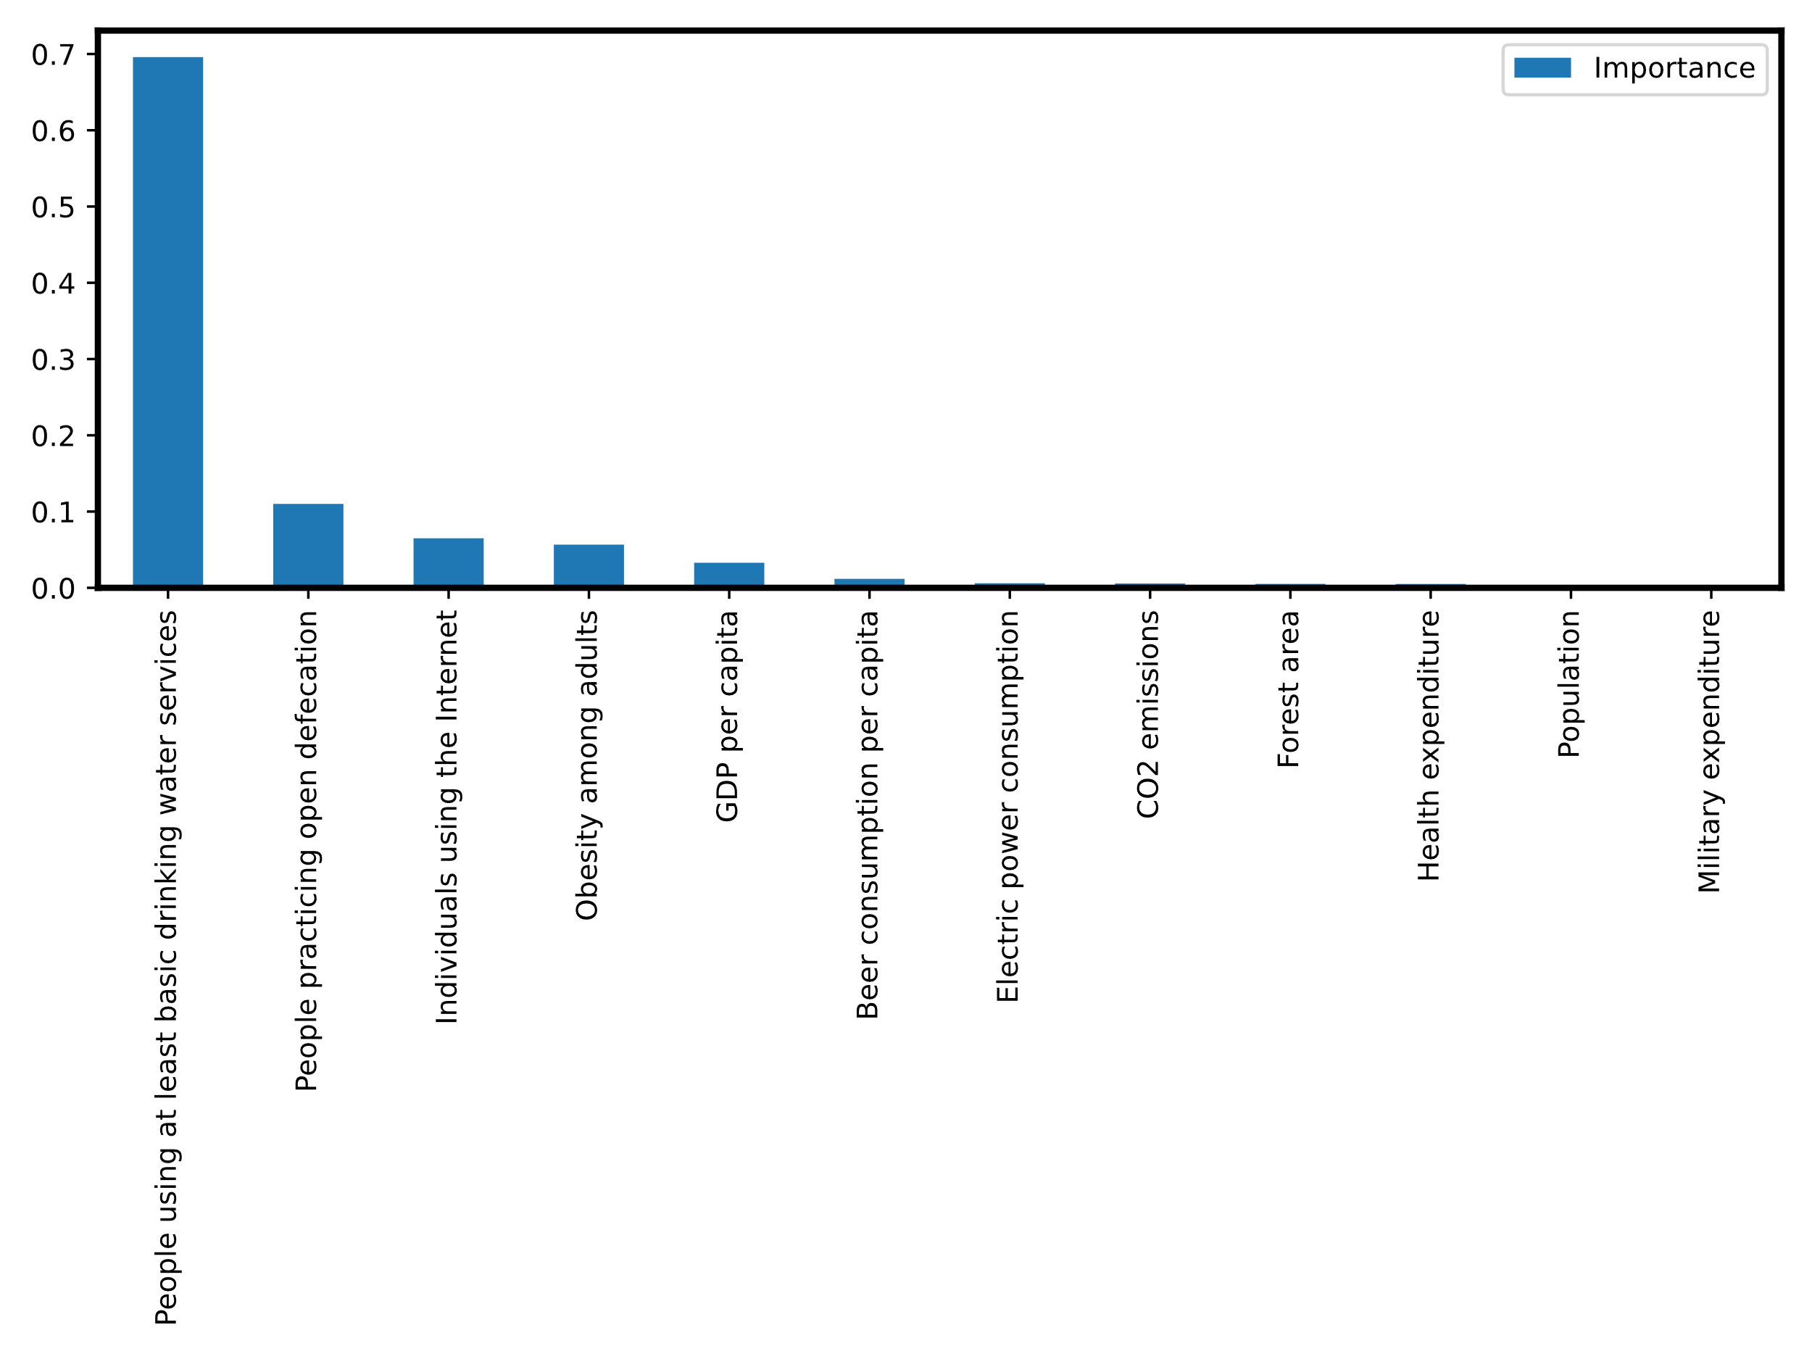
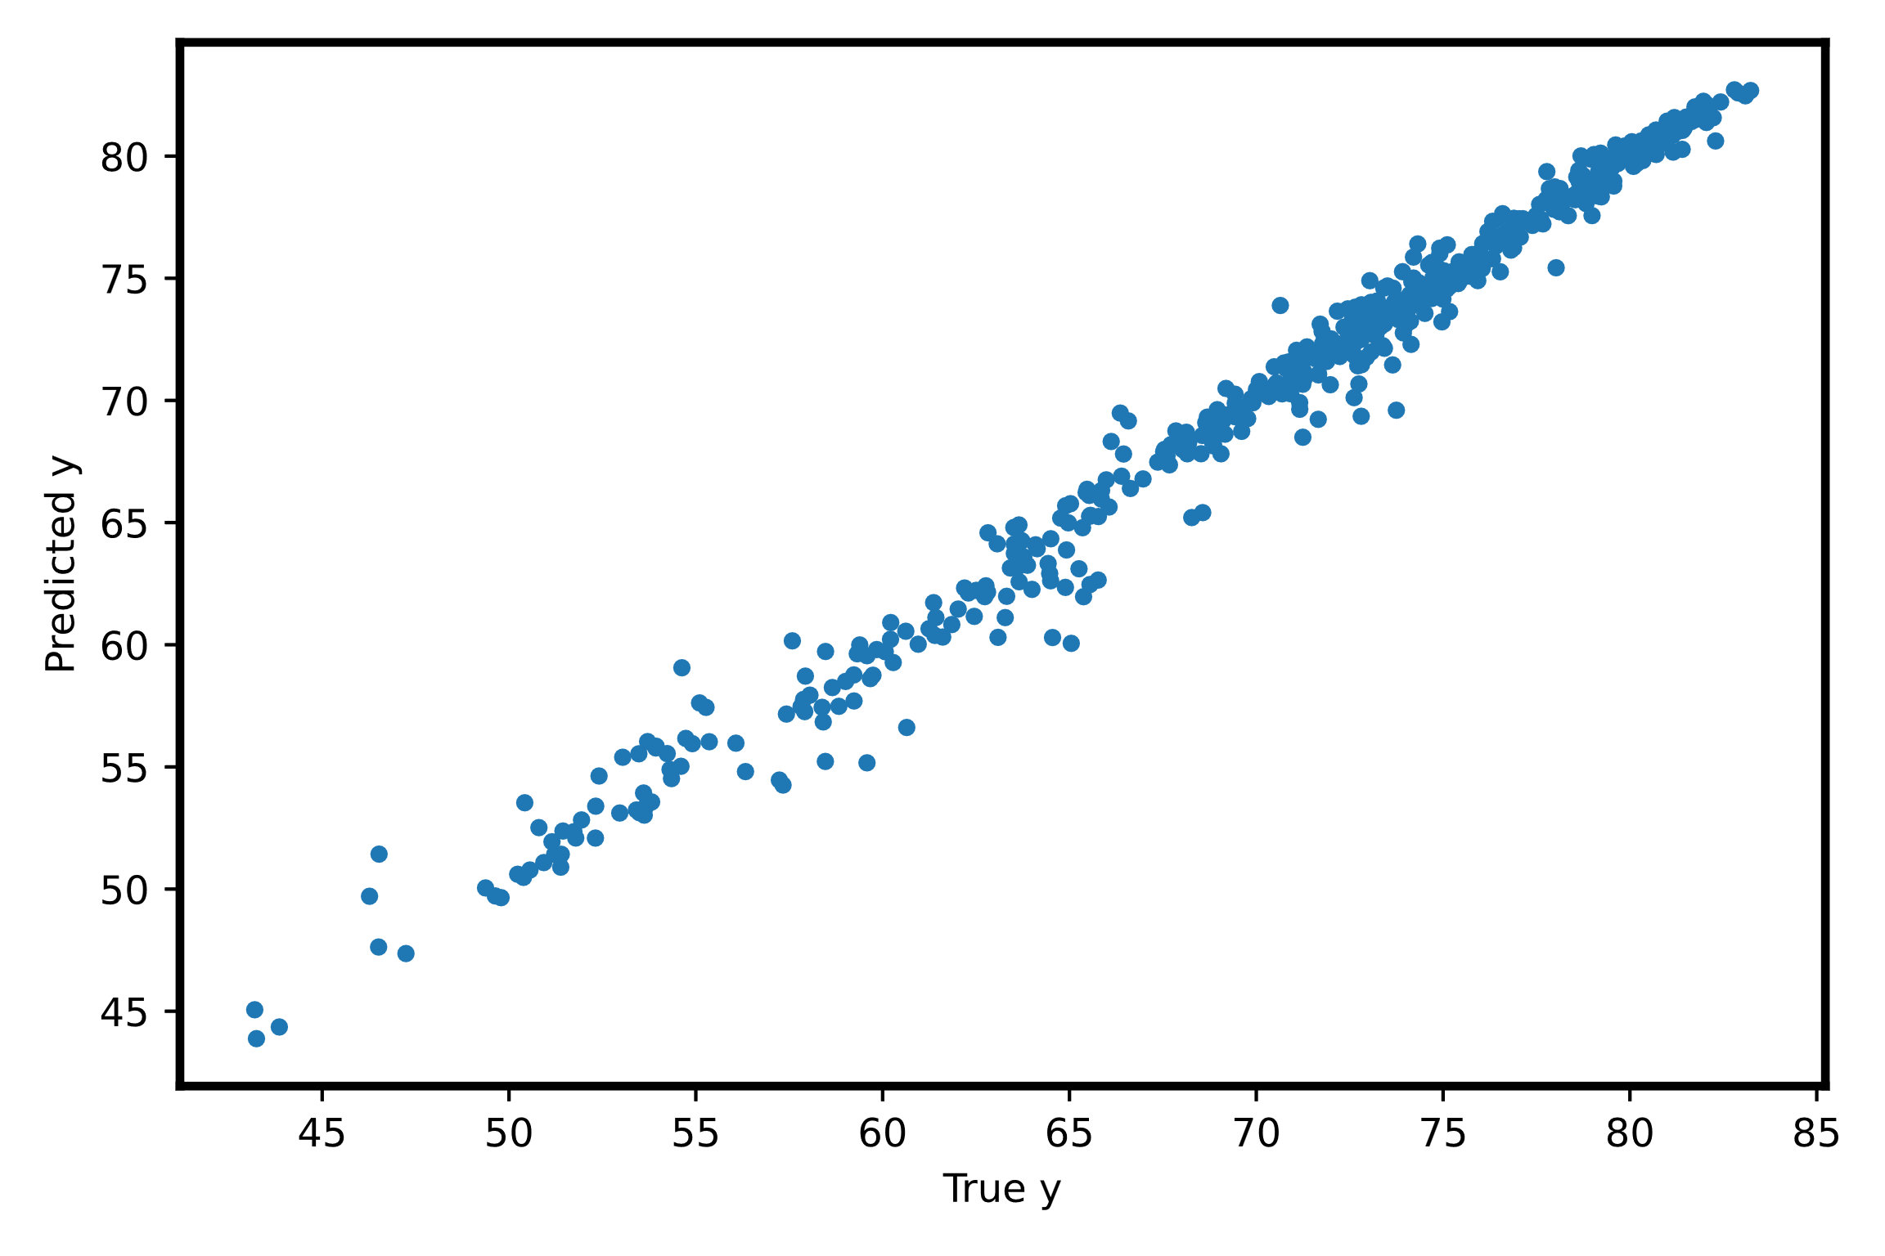
Q2 Analysis
RF and XGB Best Models (MSE ~1)
Drinking Water Feature
Pre/Post 2008 Differences (p < 0.001)

Slide 4
No Software Issues
Notes:
We are thrilled to announce that we have successfully navigated through this project without any major software issues! This is a testament to the hard work and dedication of our development team, and we are so grateful for their efforts. This achievement is truly something to celebrate, and we look forward to continuing to deliver high-quality software in the future. In addition to being a great success for our team, this milestone is also a huge win for our clients and users. The lack of software issues means that they can rely on our products to run smoothly and efficiently, without any disruptions or complications. This level of reliability and performance is critical for their success, and we are proud to be able to provide it.
Furthermore, achieving this milestone speaks to the thoroughness and attention to detail of our development process. From the initial planning stages to the final testing and deployment, every step is carefully considered and executed to ensure that the software we deliver is of the highest quality.
All in all, we are incredibly proud of this accomplishment, and we will continue to strive for excellence in all of our future projects. Congratulations to everyone involved in this success!

